Slide 1
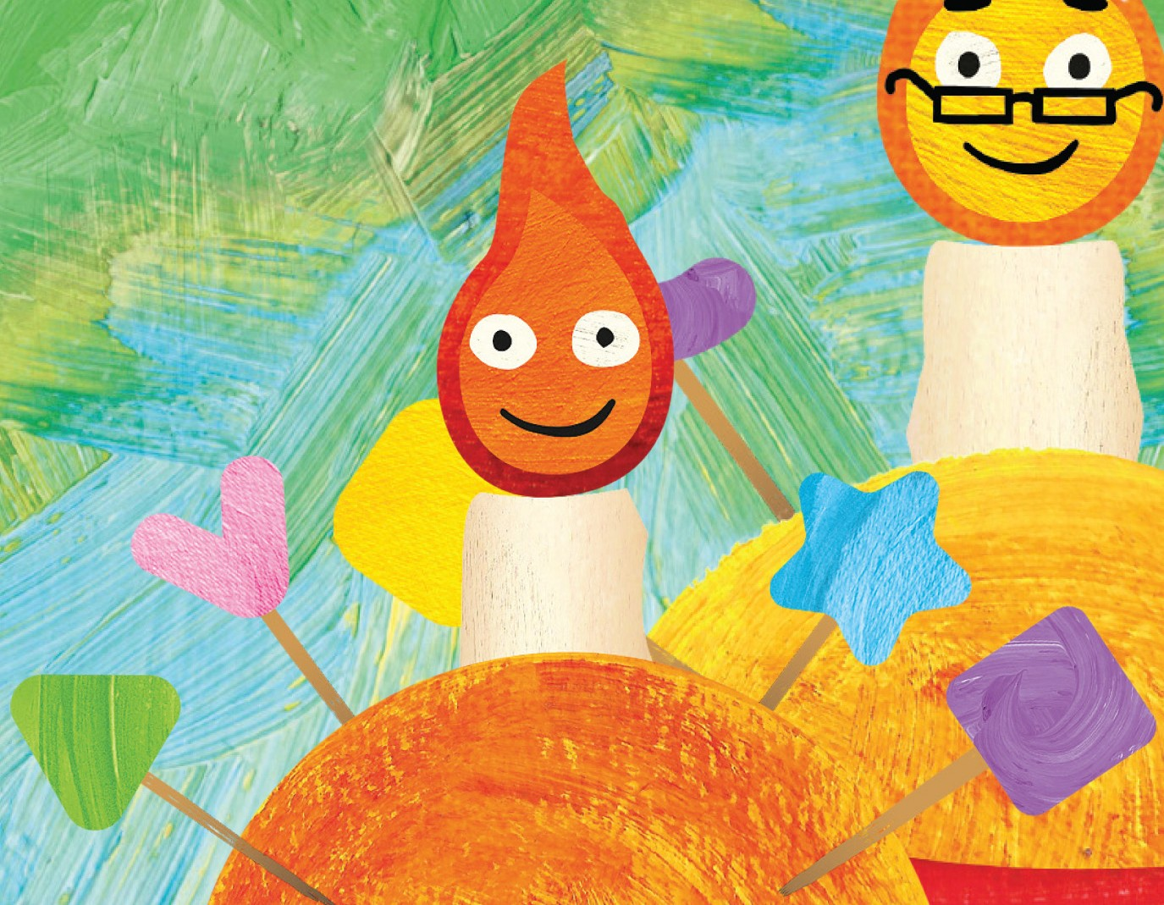
ADVENT
Challenge
Do 24 small acts of kindness (in any order!) over Advent and make the world around you a little better. On Christmas Day ask everyone in your home to read the prayer overleaf.
Make your own Christingle or bake a Christingle cake! Visit bit.ly/tcs-cake for the recipe |  | Make a Christmas decoration for your tree
Tell the Christmas story to your pet, or to a plant or teddy bear |  | Invite a neighbour in for tea
Donate a Christmas treat to a food bank |  | Put aside a bottle to donate to next year’s Deanery Fair
Phone the person who’s on your mind |  | Make up with someone you have argued with
Pray for children who are alone this Christmas |  | Pray for children caring for their families over Christmas
Talk to someone who may be sad / lonely |  | Read a story of a child helped by The Children’s Society: go to https://bit.ly/3SAI8O5
Put out some food for birds |  | Pray for someone you think is having a difficult time
Buy a gift for someone special from a Children’s Society shop or online: https://bit.ly/47qK9Rf |  | Put up Christmas lights or a decoration outside your house
Give a small bunch of flowers to someone |  | Spend a day saying nice things to everyone you meet!
Read The Children’s Society’s “How you can help” ideas - go to bit.ly/tcs-help |  | Tell someone your favourite Christmas cracker joke!
Pray Numbers 6 v24-26 for someone who needs God’s peace |  | Drop in on an elderly neighbour - maybe with a cake or picture you’ve drawn
Go to a carol service at your local church |  | Offer to help clean or tidy up your local church/churchyard
[Insert your Church logo here]

Slide 2
A Christmas prayer for the work of The Children’s
Society
Lord Jesus, born in a stable,
Give courage to all who do not have a safe place to call home.
Lord Jesus, for whom the angels sang, Give the song of the kingdom to all who weep.
Lord Jesus, worshipped by the shepherds, Give peace on earth to all who are oppressed.
Lord Jesus, visited by both wise and meek, Give wisdom and humility to all who govern.
Lord Jesus, whose radiance filled a lowly manger,
shine in our lives today,
give hope to all vulnerable children and young people and bless the work of The Children’s Society
in giving them a brighter future.
Amen
CAMPAIGN FOR CHANGE IN 2024
Become a Children’s Society campaigner in 2024. Find out how by following this link: bit.ly/tcs-campaign (please note it’s case-sensitive!)
[Insert your Church logo here]

